Slide 1




Making SharePoint News Newsworthy What’s in the box and how to extend it
SharePoint Saturday Twin Cities 2019
Doug Splinter, Director, MTC – Minneapolis
Corey Buzzell, Architect, MTC – Minneapolis
Doug Splinter
Corey Buzzell
Deck and Demo Instructions:
http://aka.ms/Newsworthy
@dsplinter
@coreybuzzell

Slide 2
How long have you been hearing about SharePoint News but still don’t use it? If you do use it, how ugly/inconsistent are the articles? How do you know if your News articles are landing?

Slide 3
3 Objectives for Making SharePoint News Newsworthy
Introduction to News in SharePoint Online
Basics
Hub Site syndication
Share across the platform
Audience Targeting
Ignite announcements
News Telemetry and Reporting
Basic: Out of the Box (OOTB)
Intermediate: M365 Usage Analytics
Advanced: Audit Log -> Power BI
Extending News
Scenario: crowd-sourced + consistent
PowerApps and Flow
Notes:
3 goals for today: introduce you to SharePoint News, provide you with a way to track read rates on News articles (any page, really), and show you how to extend SharePoint News to provide structure/consistency, and curation

Slide 4

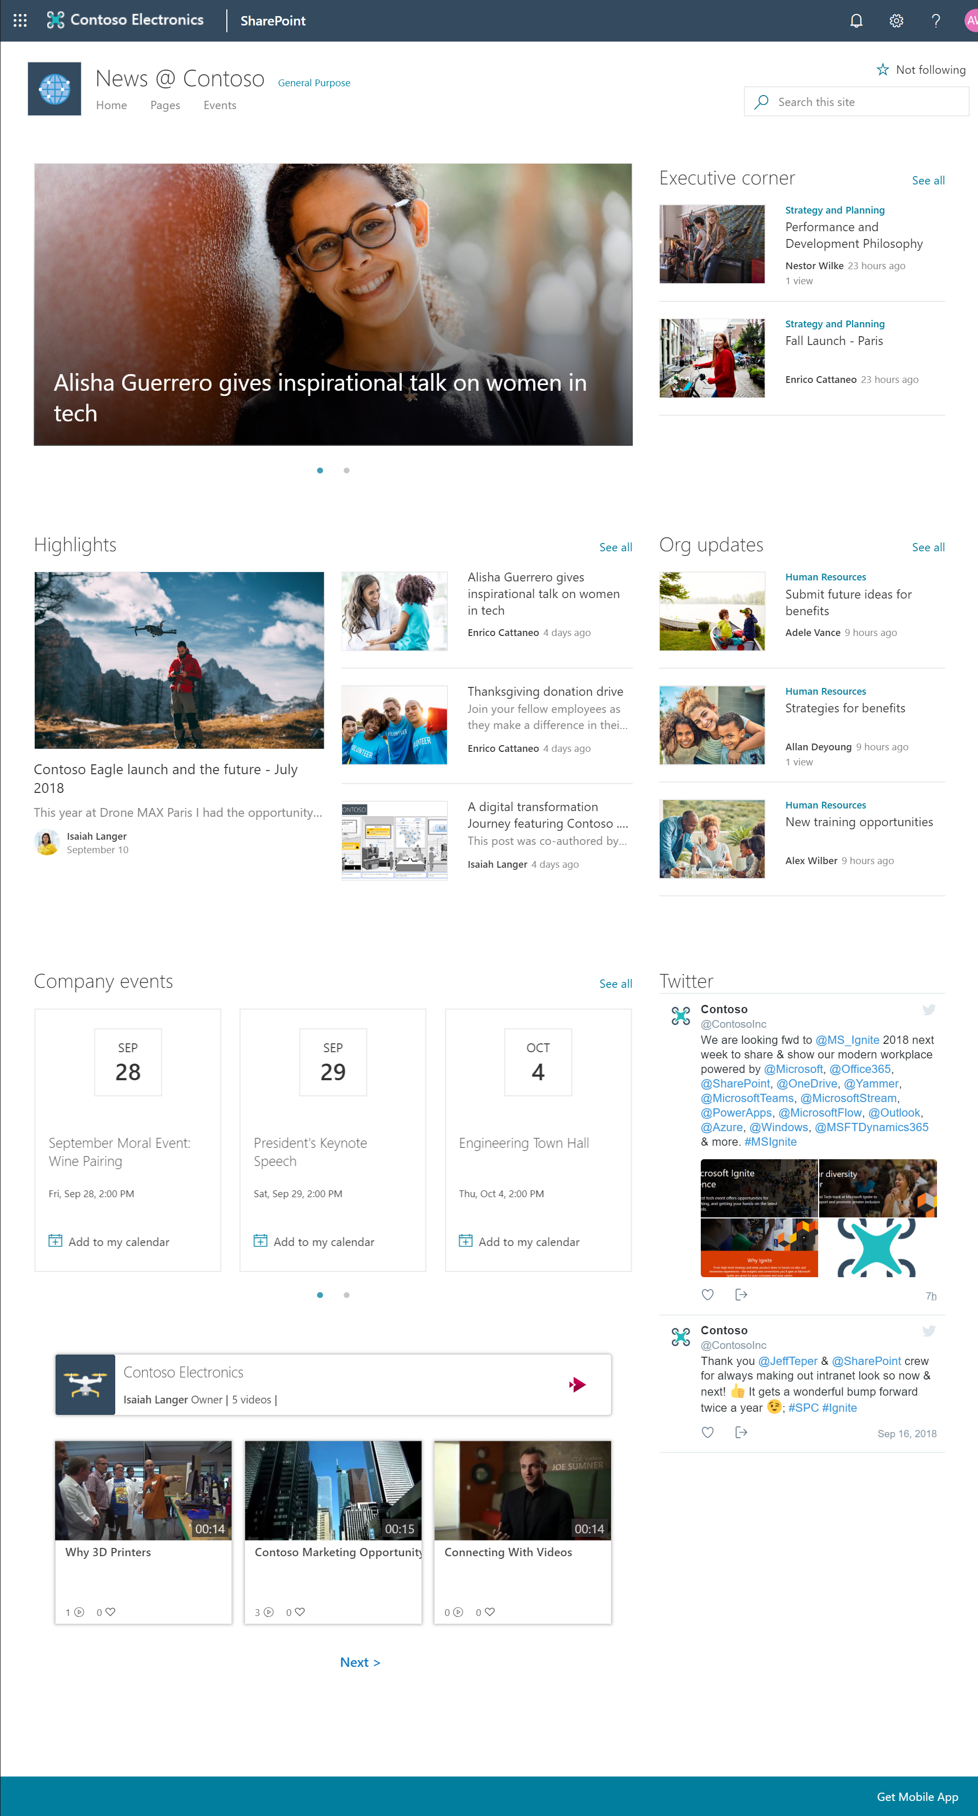
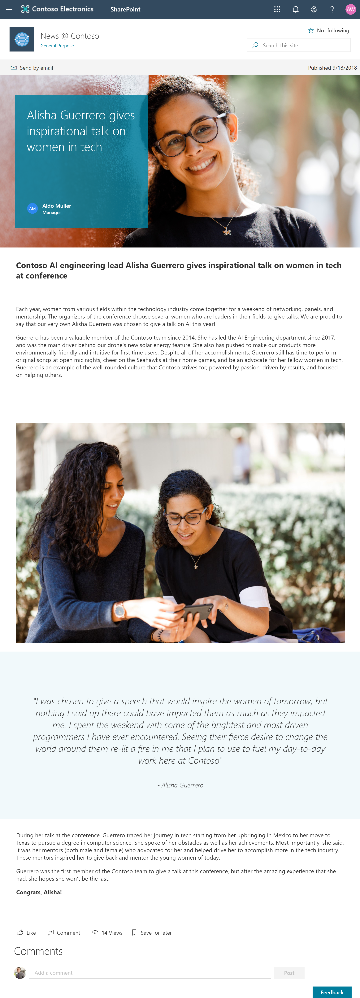


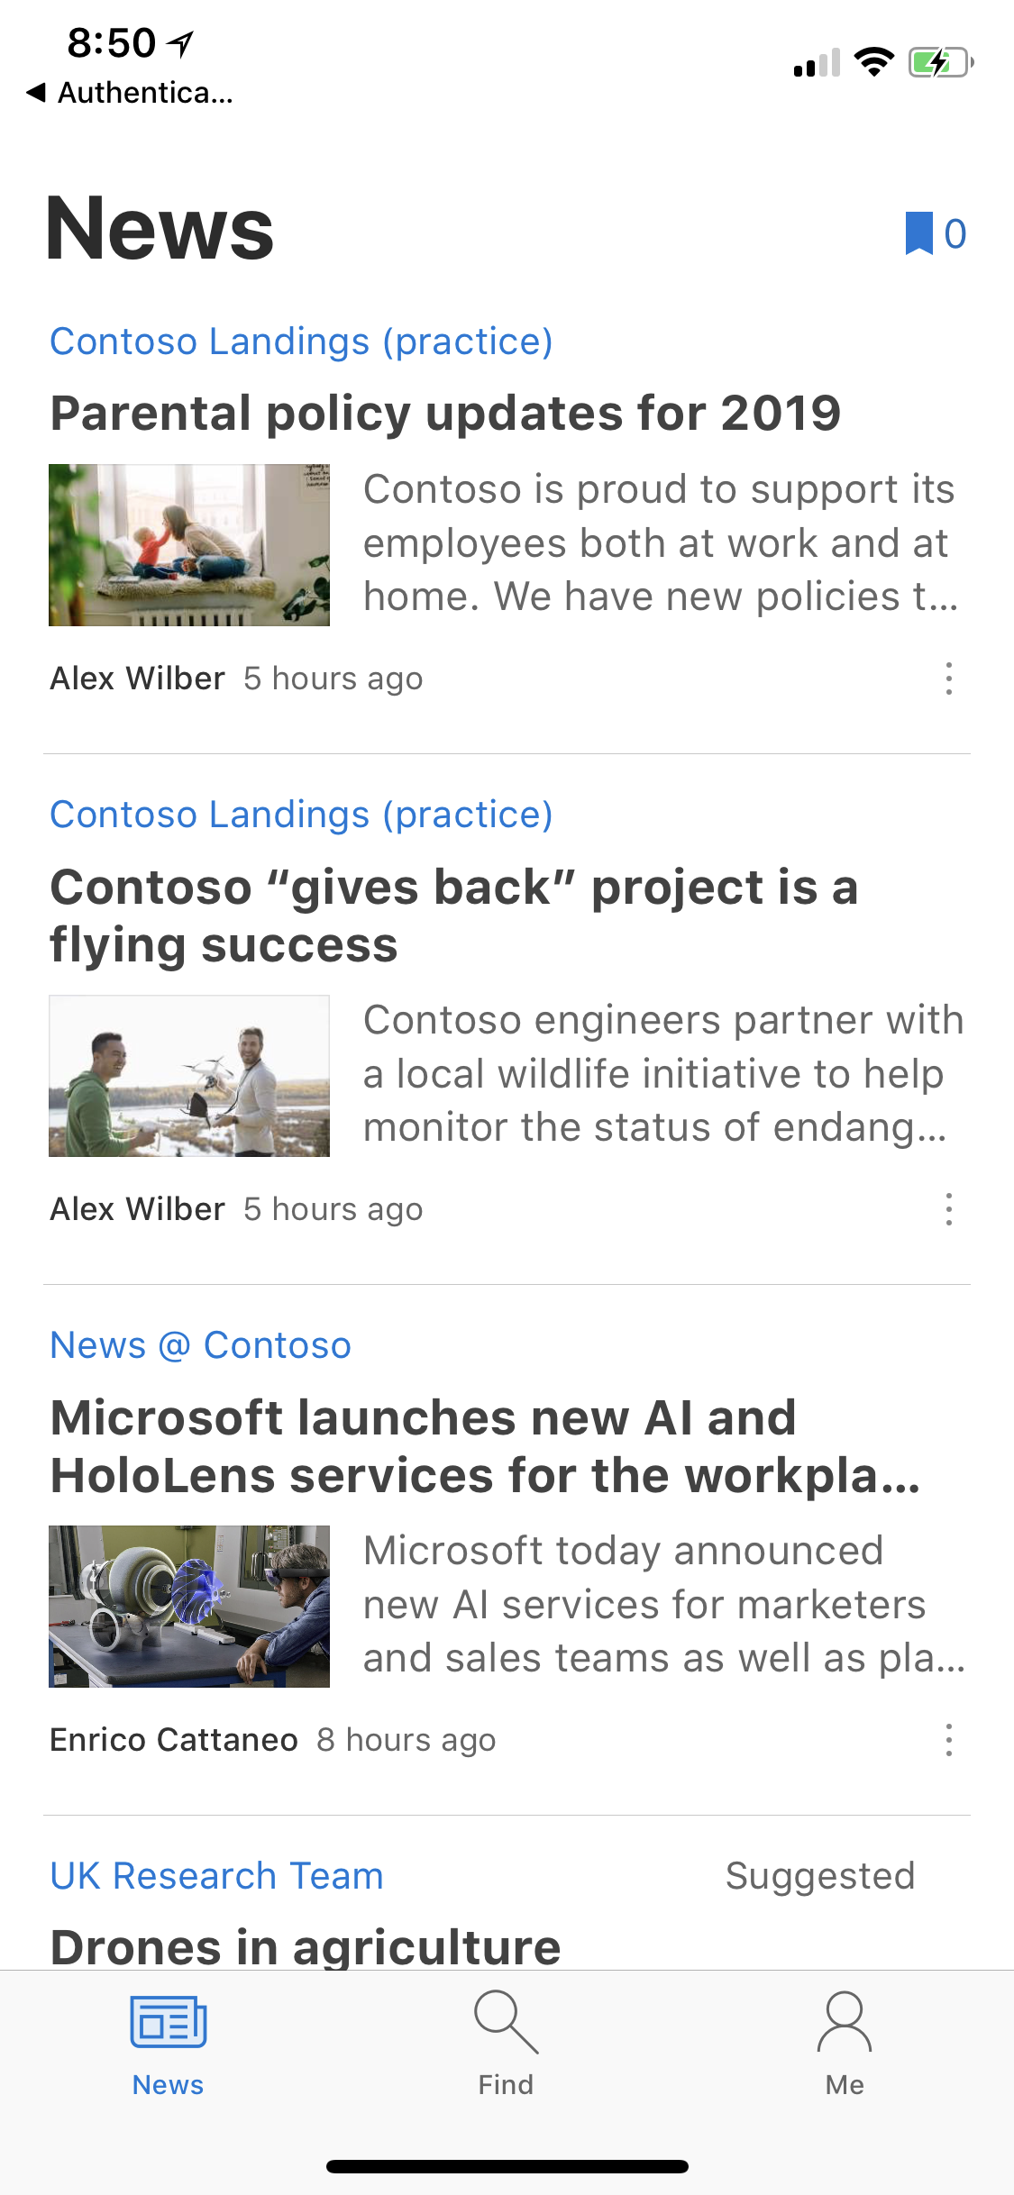
SharePoint news
Inform and engage your team and your organization
Stay in the know with important and relevant news across devices
Create compelling communications with multimedia and dynamic content from Office 365 and beyond
Scale the reach of your story with automatic news distribution and promotion to your audience
Engage your audience with likes, comments, and social re-sharing
Schedule, target, publish, distribute and measure organizational news and communications
Notes:
SharePoint News is a content distribution system that works across the spectrum of personal, team and organizational news and helps customers get their content to their audiences across SharePoint apps and experiences.
Built on modern pages and web parts to tell stories with rich, dynamic content. Modern pages are a big area of investment for us and we want to make these easy to create and manage, yet really powerful to tell your stories and to reach your audiences with high impact content.
News works across all modern sites in SharePoint – Team sites, communication sites and hubs. And it enables you to get your message to the right people.
Hub sites add the ability to roll up news posts from associated sites to get further reach for your content..
We’ve built News into Microsoft Teams to expand reach and to deliver another way of going to where people are working. We’ve added the ability also to email a news digest.
So no matter what device your readers are using or where they are – on your intranet, in Microsoft Teams, or using email – News helps you reach them.
Keep your team up to date! And do it in a way that’s easy for anyone to consume and stay engaged. With SharePoint news, you create relevant, content-rich announcements and reports that look great on any device and within other applications, including Microsoft Teams, filled with content from inside and outside Office 365.
And news articles are available to all team members even if they join the team weeks or months after publication.
We ensure that the layout works across web and mobile, and we’ve got an integrated experience in the SharePoint mobile app that gives readers the ability to interact with comments and likes on the content across web and mobile. We also have added notifications so that when a relevant news posts is published or when a comment is added that is relevant for you, you can get notified. You can even save content for reading later.
Personalized news roll-ups delivered to SharePoint mobile and home in Office 365, so that it easy to find posts that are interesting and important for you.
SharePoint news can transform your team and your organization as a way to work to post beautiful, engaging content that’s easy to author and that gets distributed to audiences you want to reach.
Additional notes
Talking points
News comes to you
Notification?
Demo mobile, first
Personalized
Empower all communicators to keep groups, departments and divisions up-to-date with team news [hubs | Teams]
Surfacing of news on site, SP home, and in Teams
Visibility & insight
Org news
Notifications
An out of the box content distribution service
Built on modern pages and web parts to tell stories with rich, dynamic content
Create news in your sites to reach your audiences
Hubs enable roll-ups across sites
Integrated into Microsoft Teams to expand reach
Works great across web and mobile, including with notifications and ways for readers to engage
Personalized news roll-ups delivered to SharePoint mobile and home in Office 365
Keep your team on the same page
Tell your story with rich, dynamic pages instead of email
Engage your audience with native commenting
Post news automatically in Microsoft Teams to raise visibility
Stay up to date, on the go with SharePoint mobile

Slide 5
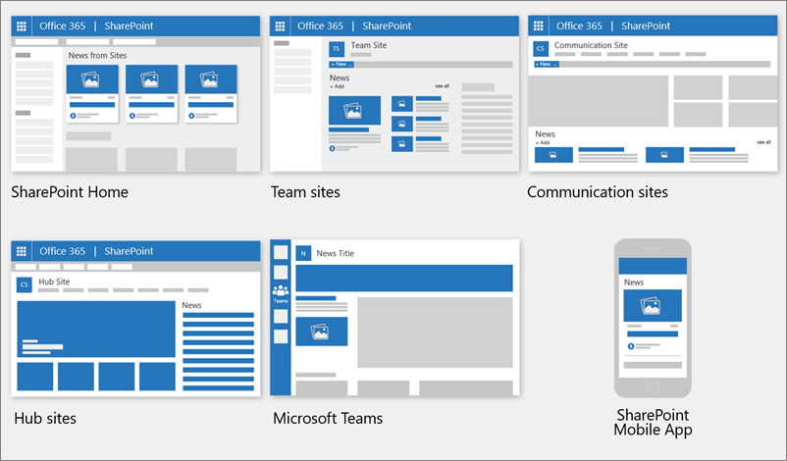
Where news is shown
News is shown as a personalized feed on the SharePoint start page and in the mobile app. It can also be shown on team sites, communication sites, and hub sites. You can also choose to show News in a Teams channel.
https://support.office.com/en-us/article/create-and-share-news-on-your-sharepoint-sites-495f8f1a-3bef-4045-b33a-55e5abe7aed7

Slide 6
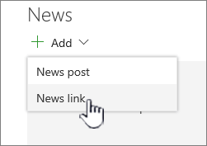
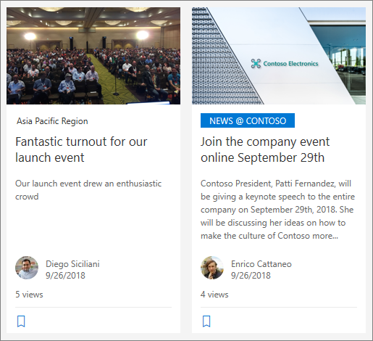
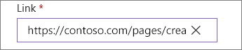
Where news is shown, continued
Personalized Feed
SharePoint blends news in your personalized feed from:
People you work with
Managers in the chain of people you work with, mapped against your own chain of management and connections
Your top 20 followed sites
Your frequently visited sites
Organization News
News from these "official" or "authoritative" sites for organization news are distinguished by a color block on the title as a visual cue and are interleaved throughout all news posts displayed for users on the SharePoint start page.
External News
In addition to News you create and host in SharePoint Online, you can link to news from other sites.
https://support.office.com/en-us/article/create-and-share-news-on-your-sharepoint-sites-495f8f1a-3bef-4045-b33a-55e5abe7aed7

Slide 7
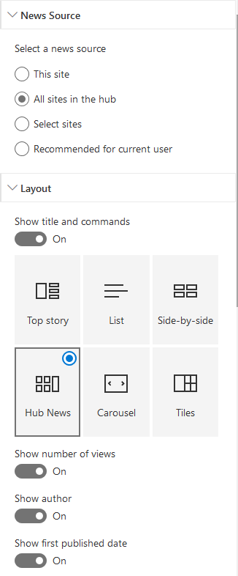
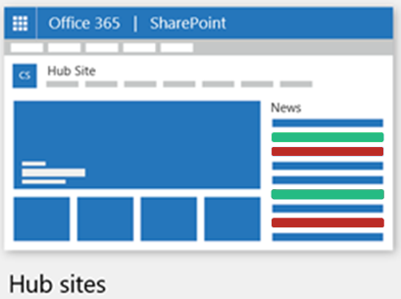
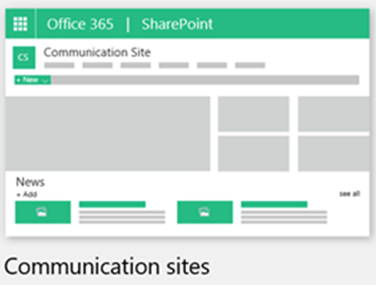
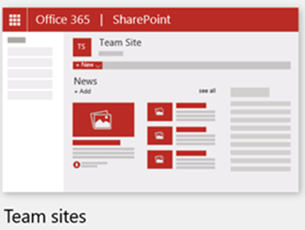
Hub Site Syndication
When you are working with a News web part, you can specify the source for your news posts. Your news posts can come from the site you are on while using the web part (This site), a hub site that the current site is part of (All sites in the hub), or one or more individual sites (Select sites). Another option is to choose Recommended for current user.
https://support.office.com/en-us/article/Use-the-News-web-part-on-a-SharePoint-page-C2DCEE50-F5D7-434B-8CB9-A7FEEFD9F165

Slide 8
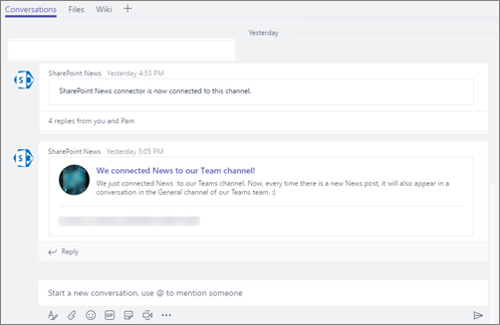
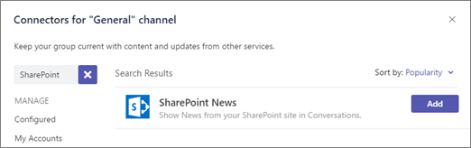
SharePoint News in a Teams Channel
To further enhance collaboration, you can configure a Microsoft Teams channel that is associated with your team site to automatically show news posts from your team site as part of a channel conversation (similar to RSS feed).
https://support.office.com/en-us/article/add-team-site-news-in-a-teams-channel-743607c0-9510-414b-8aab-1ae9ef5d3f49

Slide 9
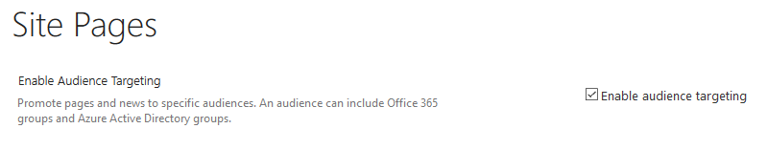
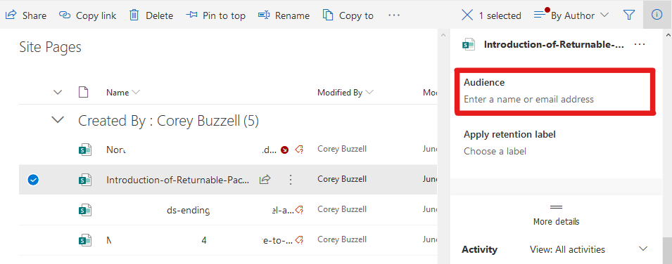
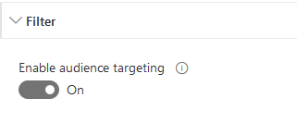
Audience Targeting
By using audience targeting, you can show news content to specific groups of people. This is useful when you want to present information that is relevant only to a particular group of people. For example, you can target news stories about a specific project to only team members and stakeholders of the project. To use audience targeting, you must:
first enable audience targeting for the pages library that contains the news stories,
select your audience (groups), and then
enable audience targeting in the News web part.
https://support.office.com/en-us/article/use-the-news-web-part-on-a-sharepoint-page-c2dcee50-f5d7-434b-8cb9-a7feefd9f165#bkmk_audiencetarget
https://support.office.com/en-us/article/target-files-news-and-pages-to-specific-audiences-33d84cb6-14ed-4e53-a426-74c38ea32293

Slide 10
Ignite 2019 Announcements (News-related)
Image resizing which gives you the ability to adjust the sizes of your images you add to your pages and news posts.
Page difference visualization and version history for pages and news posts which enables content authors to visually see what changes have been made across different versions.
News filtering across sites with managed metadata.
Yammer conversations web part (v2) which gives people the ability to ask questions, mark and discover best answers, and compose with rich text and post praises. It’s also has improved performance and is updated with a new Yammer design that is rolling out.
‘My feed’ web part that intelligently brings together relevant documents, news, activities and other content that is personalized for you.
New stock images feature which will provide several thousand high quality, high resolution images, royalty free for page and news authoring, with an inventory of images that will grow over time.
Easily schedule news posts and pages to be published at a future day and time.
https://techcommunity.microsoft.com/t5/Microsoft-SharePoint-Blog/The-intelligent-intranet-powered-by-Microsoft-365-Microsoft/ba-p/975037

Slide 11
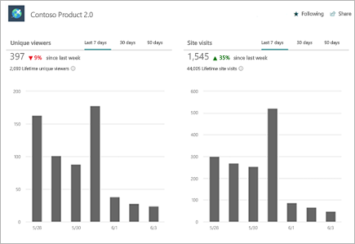
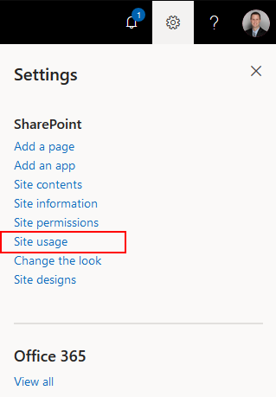
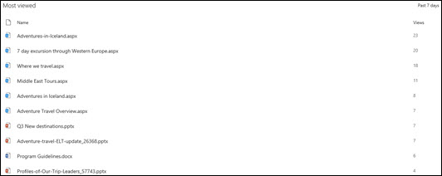
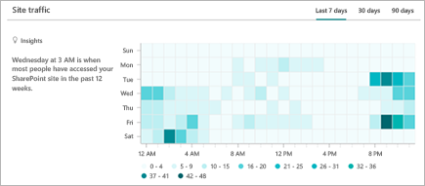
News Telemetry: Basic (OOTB)
Site Usage provides:
Unique Viewers
Site visits
Site Traffic
Popular Platforms
Most unique viewers
Most viewed
Shared with external users
https://support.office.com/en-us/article/view-usage-data-for-your-sharepoint-site-2fa8ddc2-c4b3-4268-8d26-a772dc55779e
Notes:
Site usage provides some good information about our site, but it is about just one site at a time and about the site as a whole. Often about documents. We can’t drill in to see how specific pages are doing if they aren’t showing at the top of one of these.

Slide 12
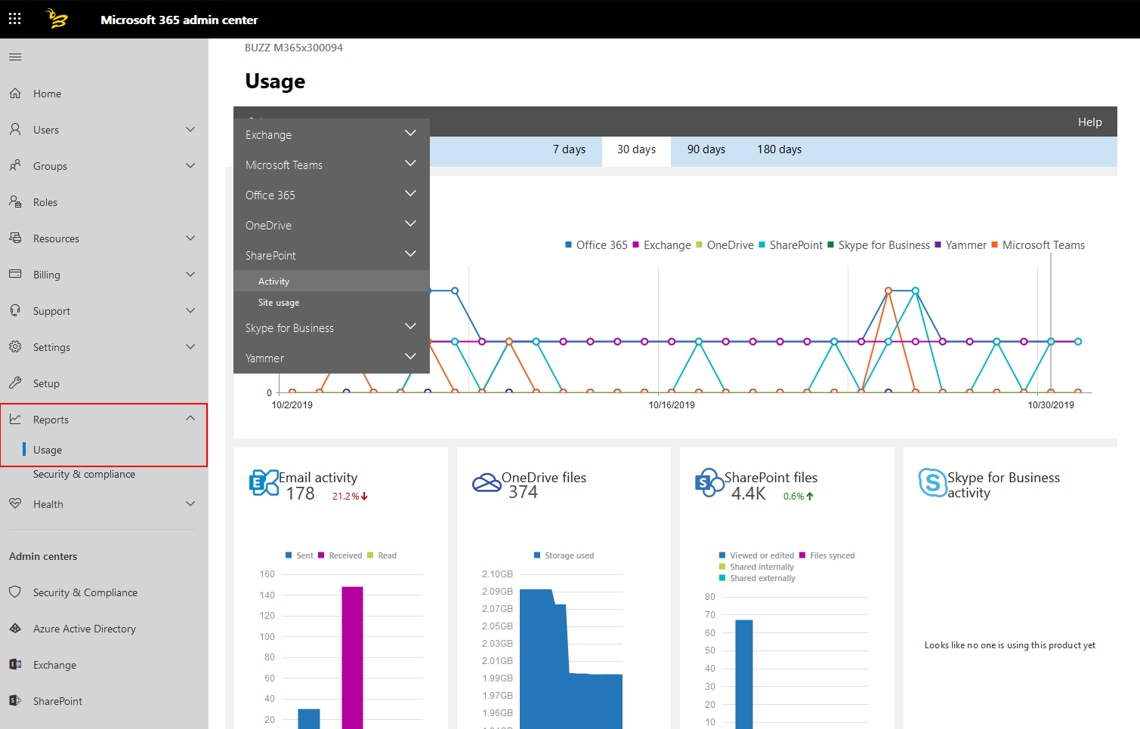
News Telemetry: Basic (OOTB), continued
M365 Admin Center Activity Reports provide:
Email activity
Mailbox usage
Office activations
Active Users
Email apps usage
Office 365 groups
OneDrive user activity
OneDrive usage
SharePoint activity
Yammer activity
Yammer device usage
Yammer groups activity
Teams user activity
Teams device usage
https://docs.microsoft.com/en-us/office365/admin/activity-reports/activity-reports?view=o365-worldwide
Notes:
Activity usage reports are good, but not quite what we are looking for this scenario

Slide 13
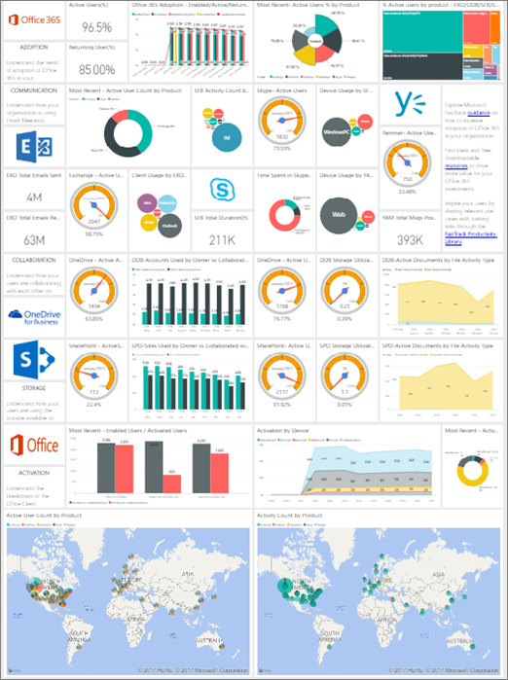
News Telemetry: Intermediate
Microsoft 365 Usage Analytics provides reports:
Product usage
Storage used
Communication
Collaboration
Office activation
Access from anywhere
Individual service usage
Individual service user activity
Enable for your tenant: https://aka.ms/EnableM365UsageAnalytics
https://docs.microsoft.com/en-us/office365/admin/usage-analytics/usage-analytics?view=o365-worldwide
Notes:
This is more information across the tenant and different services, but still not the detail for a page

Slide 14
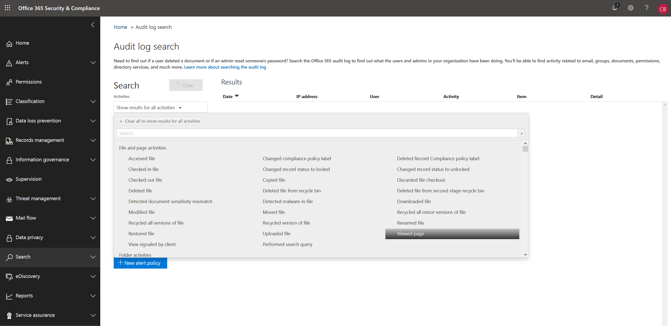
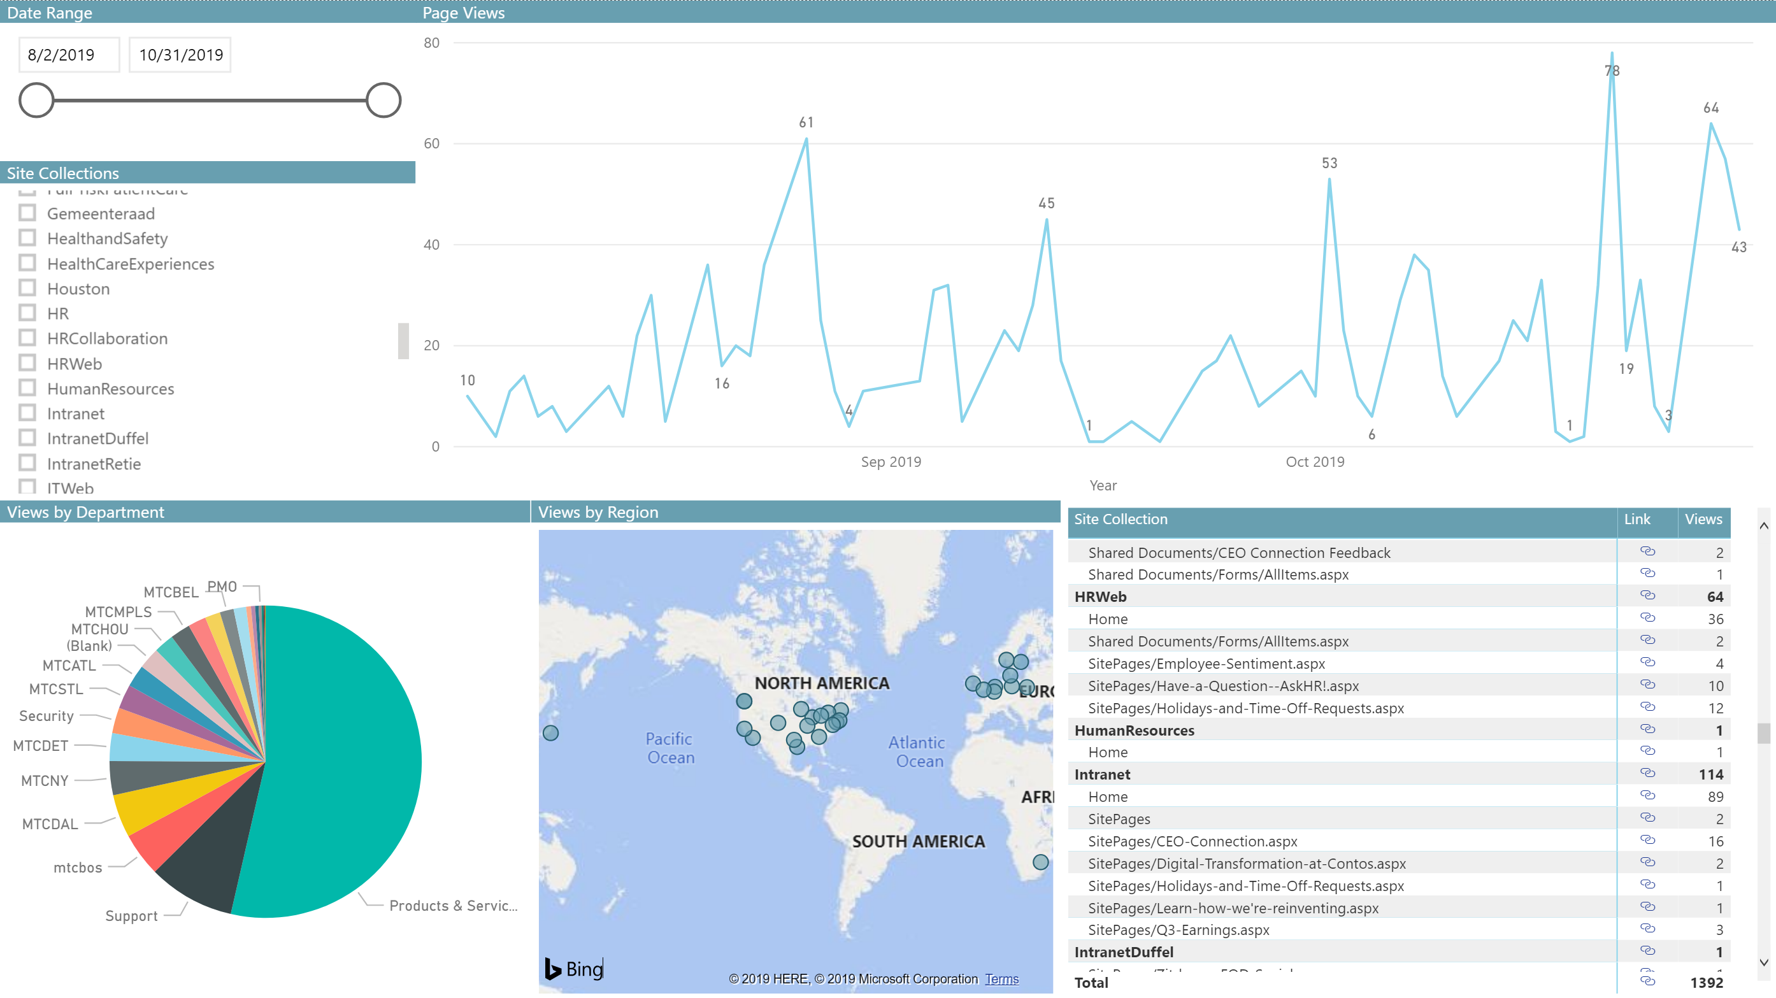

News Telemetry: Advanced (Audit Log)
Usage Analytics API
New Power BI report
Office 365 Audit Log
Export as often as you want and drop those files in a folder that Power BI will combine together
https://aka.ms/SharePointNewsTelemetry
Notes:
So, let’s build our own report to get exactly what we need: views per page across the tenant. This is also something we can easily give our Corp Comm / HR teams access to.

Slide 15
Show it time!

Slide 16
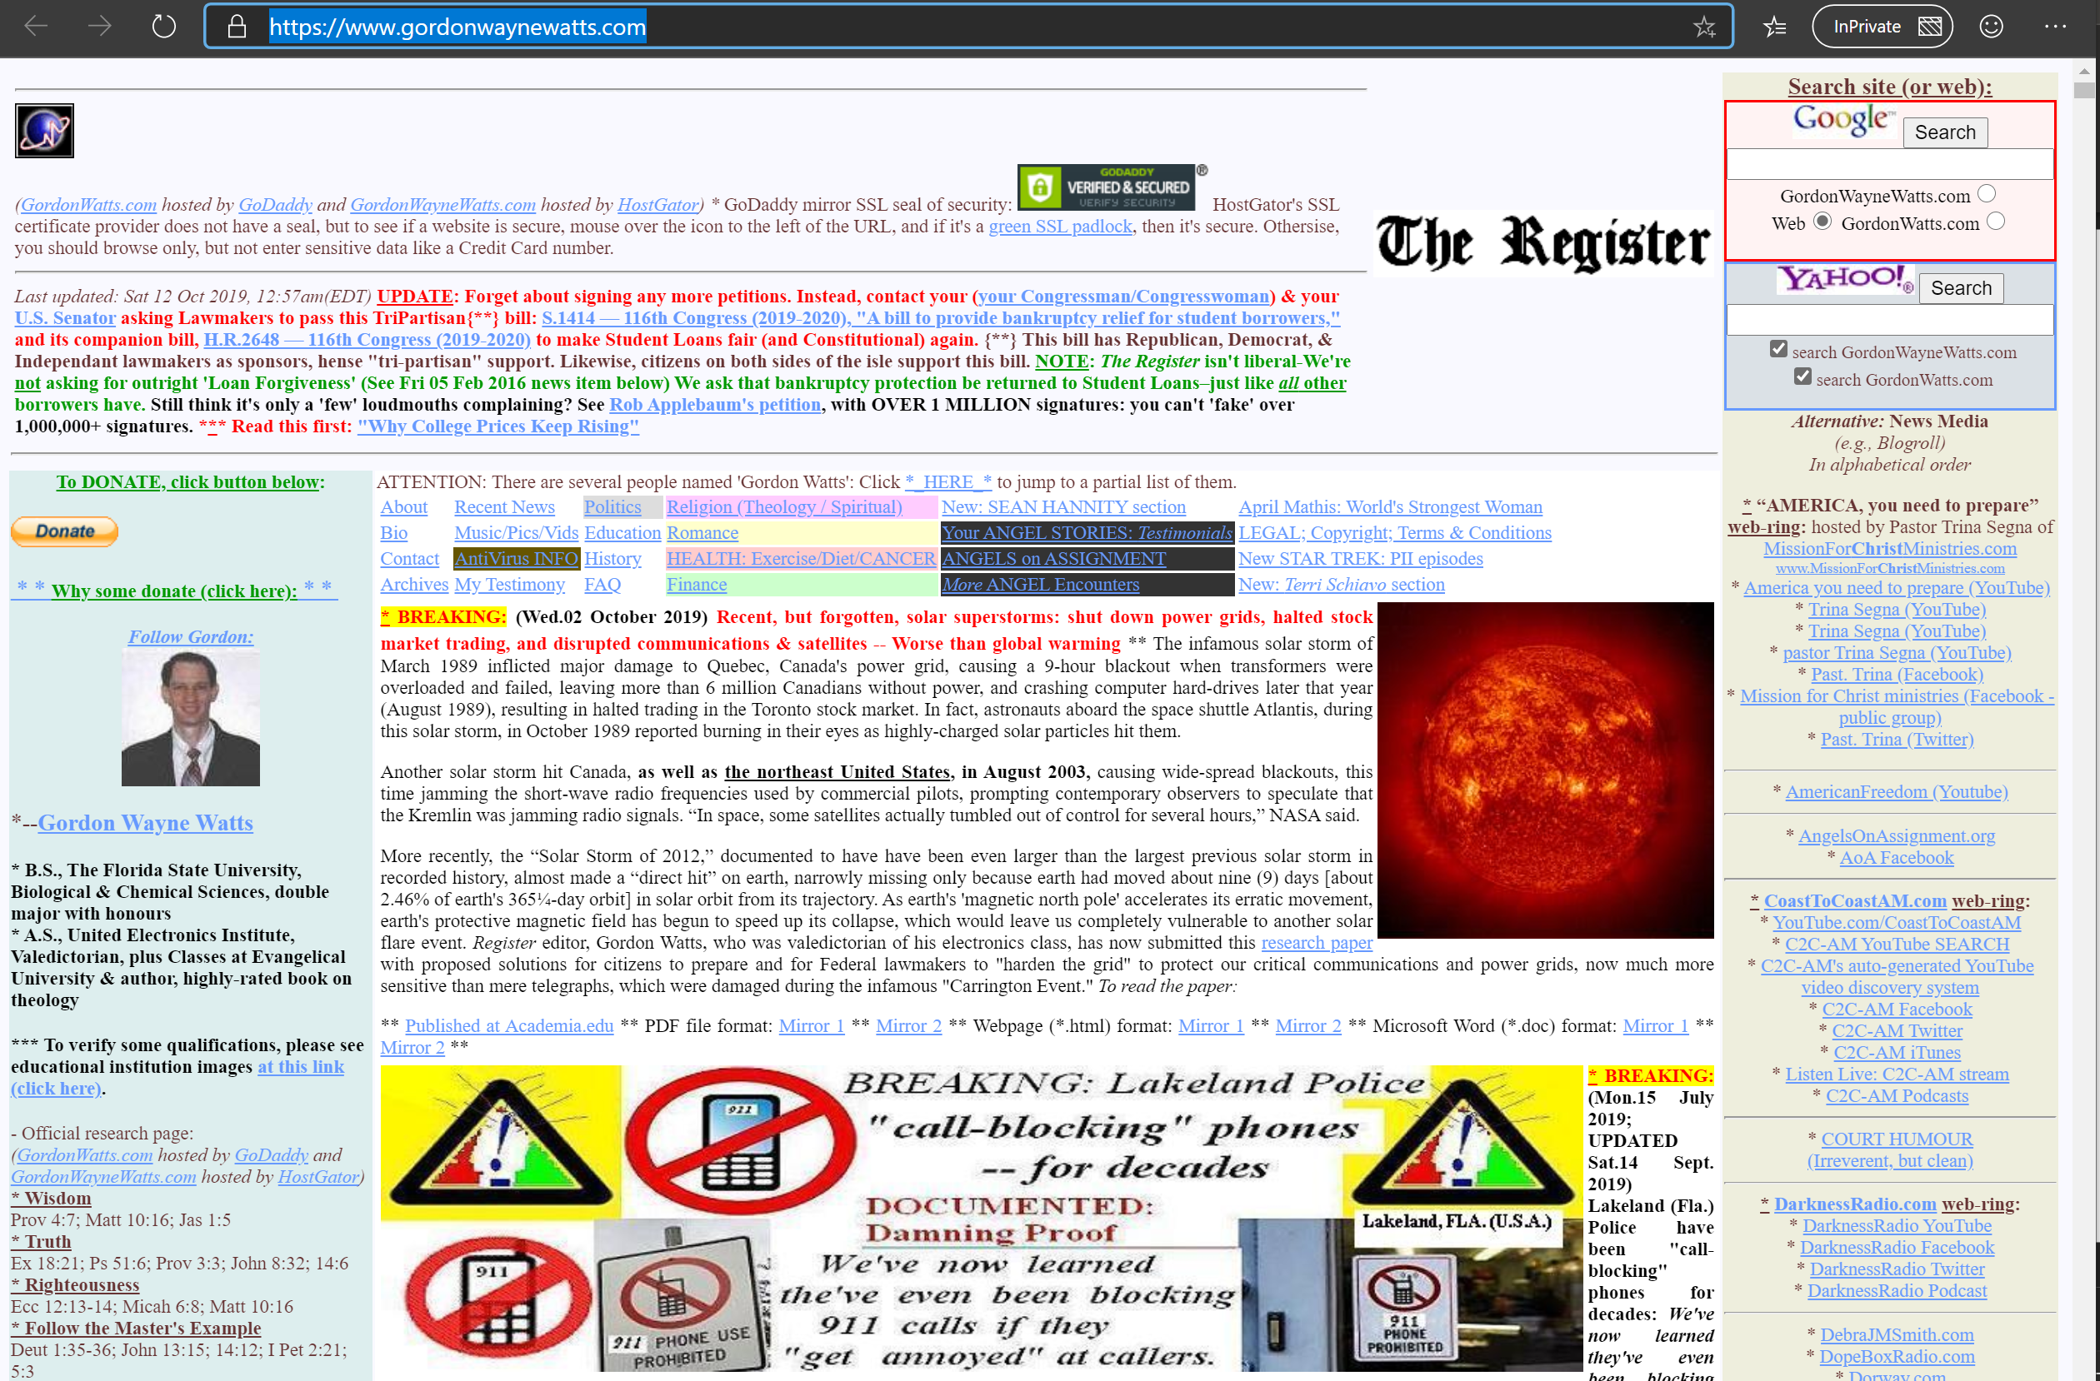
Problem: People don’t always make great web pages
And News pages are web pages, so…not all look great
Common issues:
Format
Consistency
Accessibility
Readability
Brand
https://www.gordonwaynewatts.com/

Slide 17
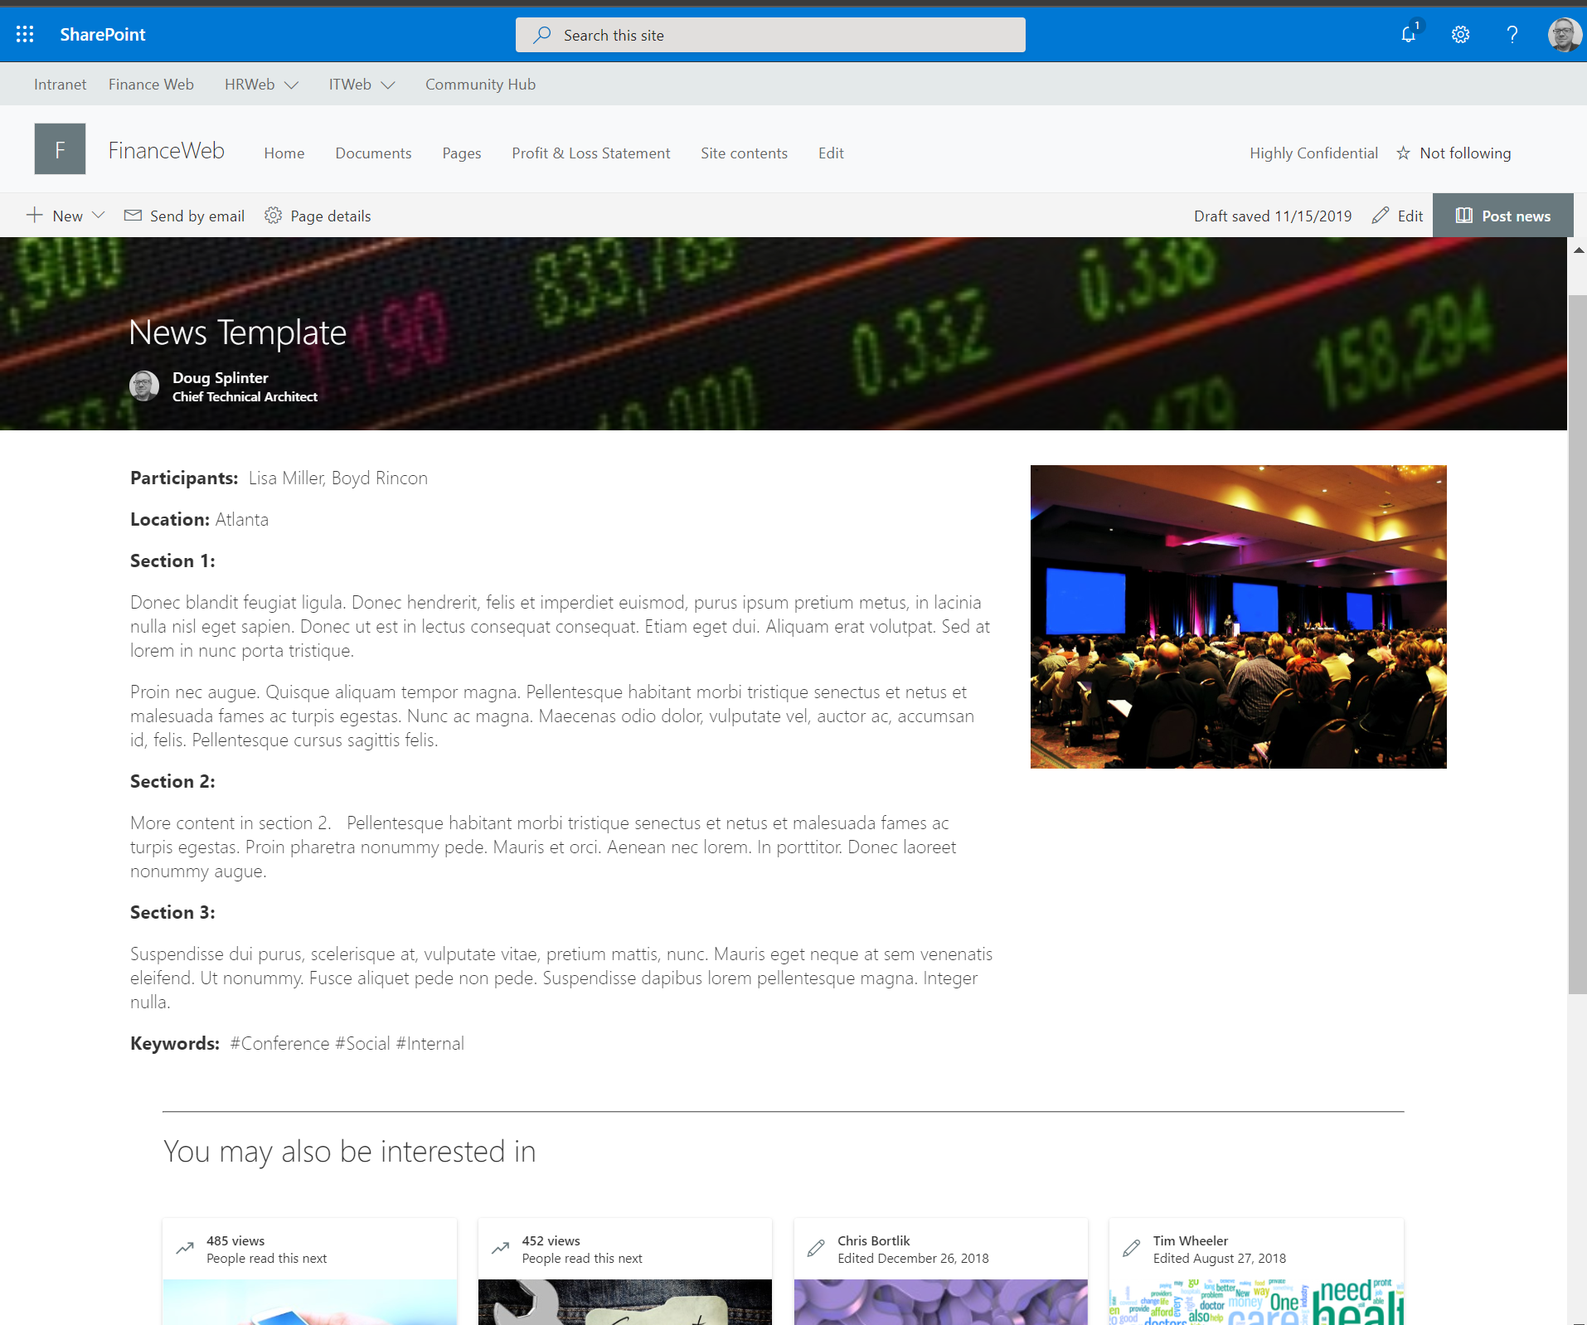
For SP News, we want curation and structure!
It may not be as “creative” as self-created news, but how about something like this:

Slide 18
Sample Power Platform-based News workflow
Power Platform can be used as an authoring and publication tool
Story Draft/Submit to SP List via PowerApp Tool
Flow Alert > Comms/Business Proof/Review
Publish as SharePoint News – SP Site
Manual Sharing – link/newsletter
Automated Sharing/Syndication – Teams/Yammer/SPO
Github Link (insert link)

Slide 19
Show it time!

Slide 20
For later: SP List List Specs
Name | Type | Purpose | Required
Title | Text | Story/news article title
Author | Person | Author via lookup - main writer of the story, will be assigned to page author at top
WorkflowState | Text | Managed via process Flow - state drives UI via PowerApp
Participants | Person w/multi | People who delivered or helped | x
Location | Choice | Office/Site Locales | x
Section1 | Multi-Line Text | Text Section 1 | x
Section2 | Multi-Line Text | Text Section 2 | x
Section3 | Multi-Line Text | Text Section 1 | x
Keyword1 | Choice w/multi | Keyword list | x
PubDate | Date | Publish Date of Story to a News post
PubURL | Text | Generated from workflow
Attachments | Photo | Picture used (if provided) in story/news

Slide 21
Recap of today’s objectives
Introduced you to SharePoint News
Provided you with a way to track News read rates
Showed you how to extend News to provide structure/consistency and curation

Slide 22
Appendix

Slide 23
References
Create and share news on your SharePoint sites: https://support.office.com/en-us/article/create-and-share-news-on-your-sharepoint-sites-495f8f1a-3bef-4045-b33a-55e5abe7aed7
Use the News web part on a SharePoint page: https://support.office.com/en-us/article/Use-the-News-web-part-on-a-SharePoint-page-C2DCEE50-F5D7-434B-8CB9-A7FEEFD9F165
Add team site News in a Teams channel: https://support.office.com/en-us/article/add-team-site-news-in-a-teams-channel-743607c0-9510-414b-8aab-1ae9ef5d3f49
Target files, news and pages to specific audiences: https://support.office.com/en-us/article/target-files-news-and-pages-to-specific-audiences-33d84cb6-14ed-4e53-a426-74c38ea32293
View usage data for your SharePoint site: https://support.office.com/en-us/article/view-usage-data-for-your-sharepoint-site-2fa8ddc2-c4b3-4268-8d26-a772dc55779e
Microsoft 365 Usage Analytics: https://docs.microsoft.com/en-us/office365/admin/usage-analytics/usage-analytics?view=o365-worldwide
The intelligent intranet powered by M365 - Microsoft Ignite 2019 announcements: https://techcommunity.microsoft.com/t5/Microsoft-SharePoint-Blog/The-intelligent-intranet-powered-by-Microsoft-365-Microsoft/ba-p/975037
GitHub repo for SharePoint News Reporting: https://aka.ms/SharePointNewsTelemetry
GitHub repo for extending news solution: https://aka.ms/newsworthy

Slide 24
















Thank you #SPSTC sponsors!

